Slide 1
Air Quality – L7
Virendra Sethi
vsethi@iitb.ac.in
7809

Slide 2
Goal of the Air Quality Module
You will be able to explain key concepts of air pollution and air quality management

Slide 3
Air Pollution Control - PM
MECHANICAL
Gravity – Settling Chambers 20 -100 μm
Inertia - Cyclones > 25 μm
Diffusion – Filters > 0.1 μm
ELECTRICAL
Electrostatic Precipitators > 0.1 μm

Slide 4
Control of Gaseous Pollutants

Slide 5
Air Pollution Control - Gases
Absorption
Adsorption
Incineration
Chemical Reactions
Catalysts
Flue gas Desulphurisation

Slide 6
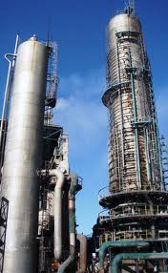
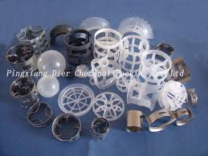

Slide 7
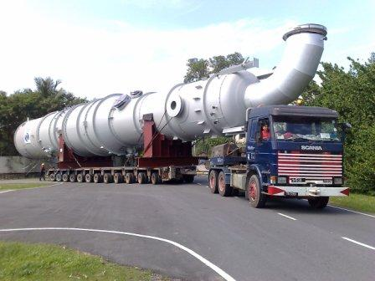

Slide 8
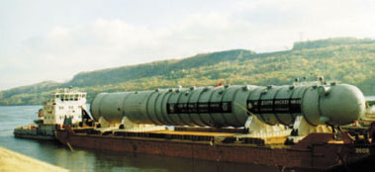

Slide 9


Adsorption

Slide 10
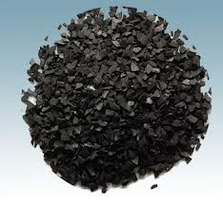
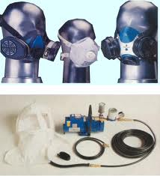

Slide 11
Incinerators - Flares

Slide 12
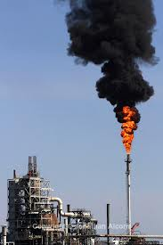
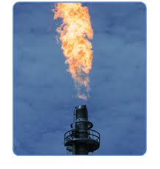

Slide 13
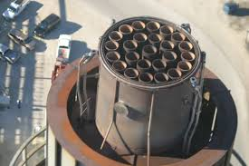

Slide 14
To Learn Today
District Collectors’ perspective

Slide 15
Key Steps in Air Quality Management (AQM)

Slide 16
Meteorological Data
Criteria Pollutant Measurements
Ongoing + Historical data
National Standards (CPCB)
Topography
COMPARE
Inventory of
Sources (Point, Line, Area)
Dispersion Modelling
In Compliance
NOT
in Compliance
Results for Various Scenarios (BAU and Possible Interventions)
Look out to prevent any significant deterioration
☺ For now
COMPARE
* Chemistry used for forensics
Possible Reasons for Differences
Are all sources accounted for ?
Are Industries* in Violation?
Carrying Capacity
Mitigation Measures

Slide 17
Chandrapur A Case Study

Slide 18
Map of Emission Sources and AAQ Monitoring Stations in Chandrapur
18

Slide 19
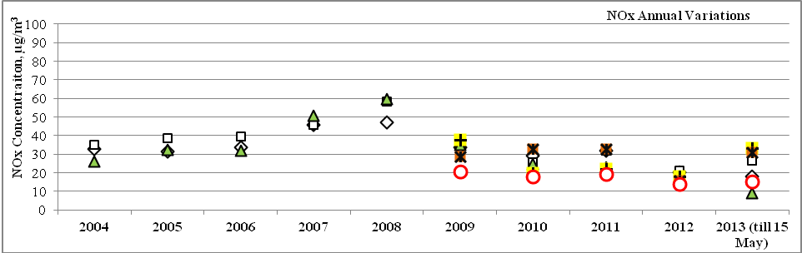
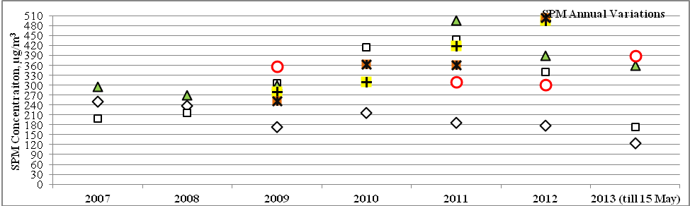
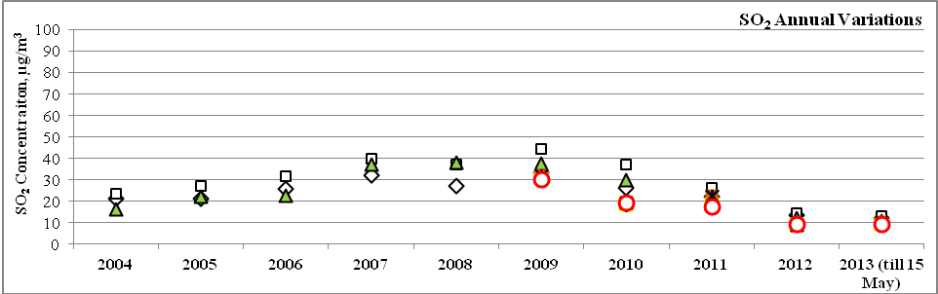
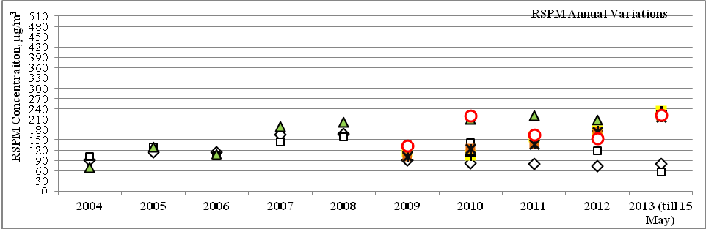
Annual Variation of NOx, SO₂, RSPM and SPM Concentrations at the Six Monitoring Stations in Chandrapur, Averaged Over the period from 2004 to 2013
CPCB Standard Limit

Slide 20
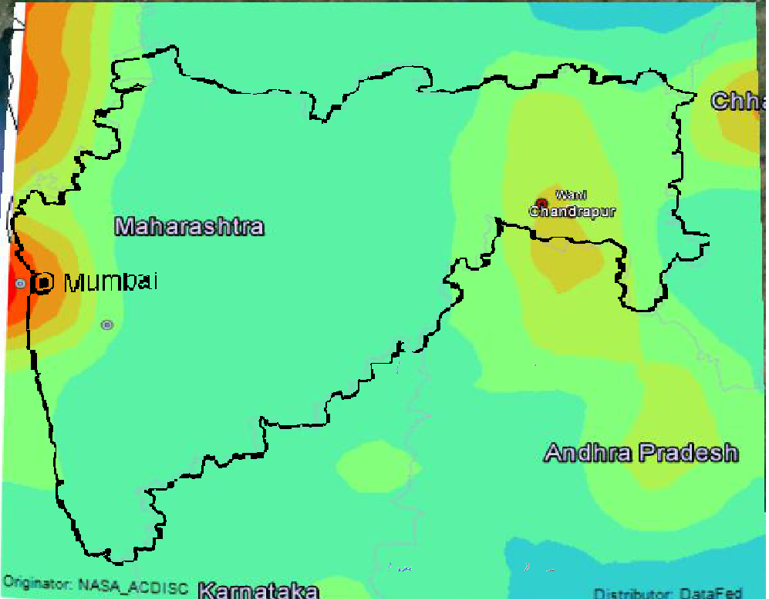
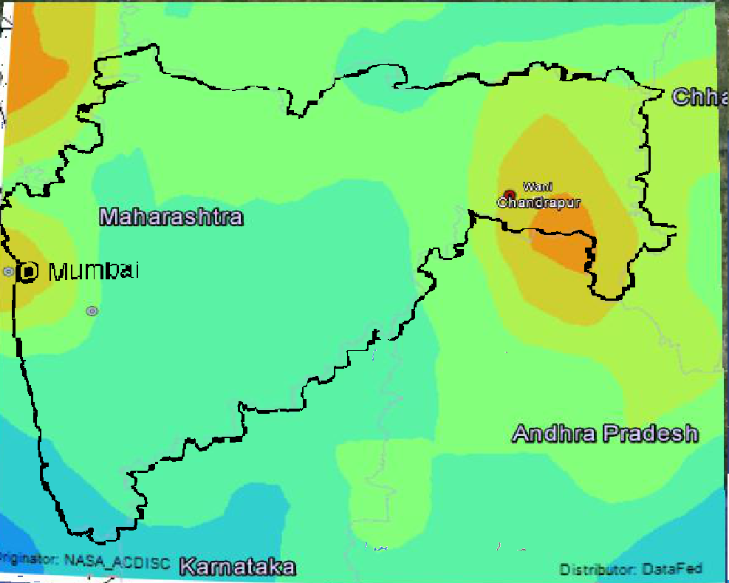
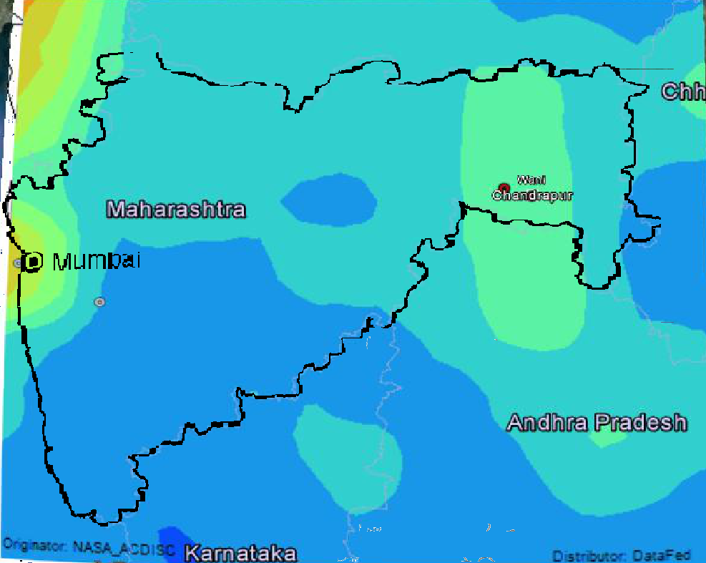
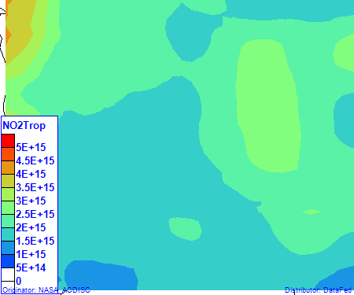
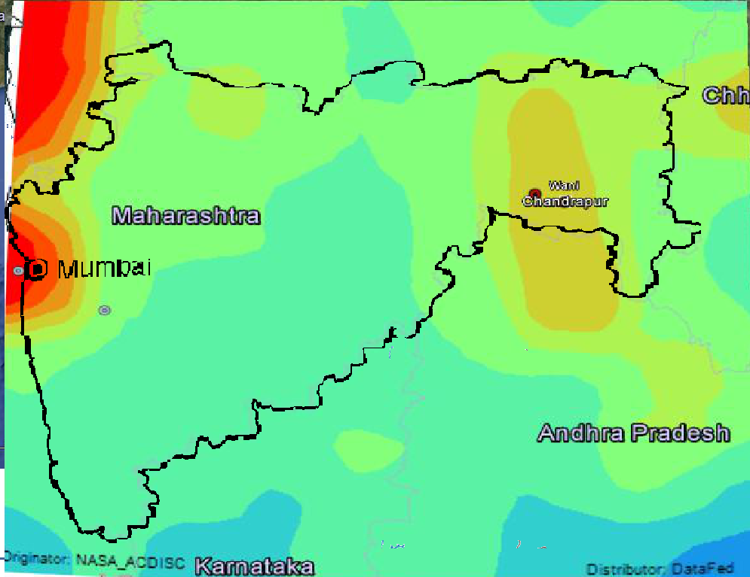
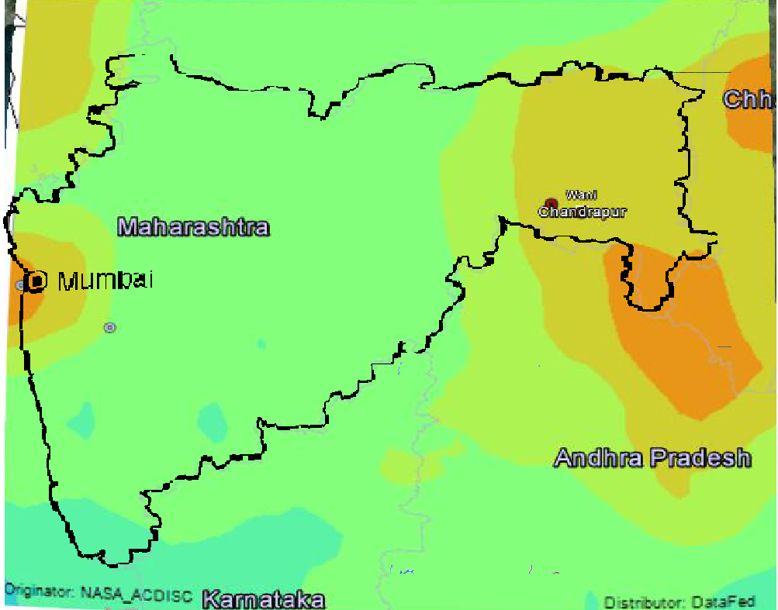
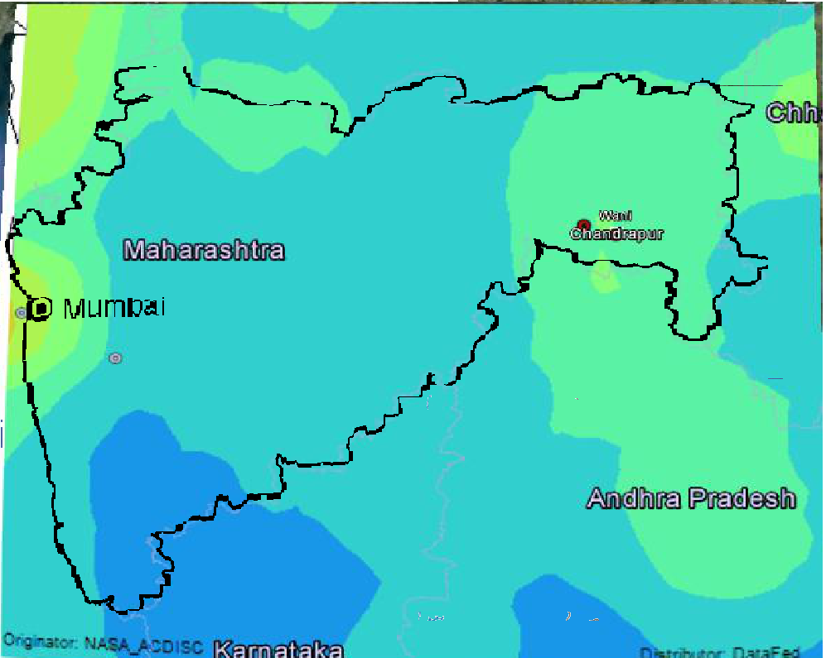
Seasonal Patterns of Columnar NO2 Density over Maharashtra
Dec-Feb
March-May
Sept-Nov
2005-2006
2009-2010
September 1, 2020
CESE, IIT Bombay
20/20

Slide 21
Air Quality Modeling
for
Chandrapur Region

Slide 22
Input Data for Air Quality Modeling
Model : Version 8.8.9 of AERMOD View Lakes Environmental Software
Inventory Data
Point : 115 Chimneys from 30 Industries
Line : 7 Major Roads covering 11 junctions over 9km x 12 km Chandrapur City (NEERI)
Area Sources :
Unorganised Area Sources : Chandrapur City Spread over
9 km x 12 km
Mines : 18 Coal Mines (Area Sources) over Chandrapur District

Slide 23
Input Data for Air Quality Modeling
Continuation…
Meteorological Data
MM5 data of 12km x 12km resolution surface and upper air meteorological
data for Chandrapur region
Receptors
6-NAMP Stations in Chandrapur District
2-CAAQMS stations (operated by MPCB and CSTPS) in Chandrapur City
7-Seasonal Measurement Locations (Using MiniVol) in Chandrapur City
11- point loop locations in Chandrapur District
Terrain Data
USGS-SRTM 30 m resolution DEM terrain data for Chandrapur region

Slide 24
Assessment of Alternative Meteorological Datasets
for
Chandrapur Region
Air Quality Modeling

Slide 25
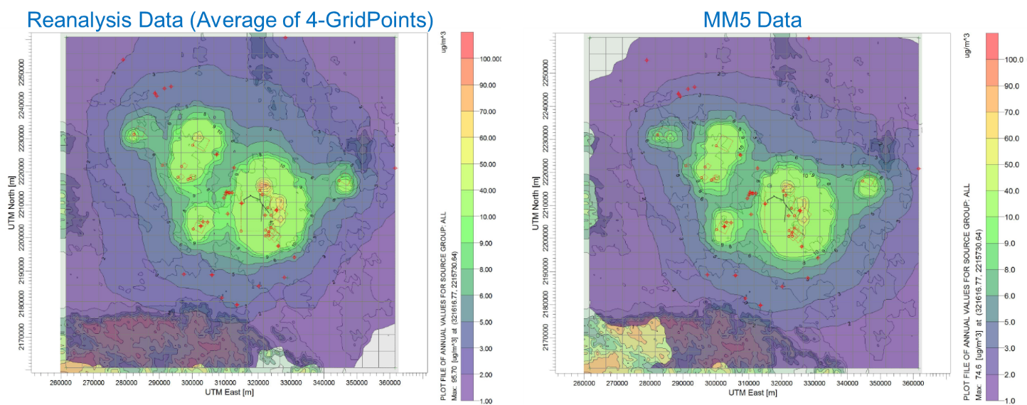
Comparison between outputs of AERMOD annual averaged PM₁₀ concentration isopleths using input of MM5 data and Reanalysis data

Slide 26
Model Results for the PM at the Six NAMP Stations

Slide 27
Map of Emission Sources and AAQ Monitoring Stations in Chandrapur
27

Slide 28
Map of Emission Sources and AAQ Monitoring Stations in Chandrapur
28

Slide 29
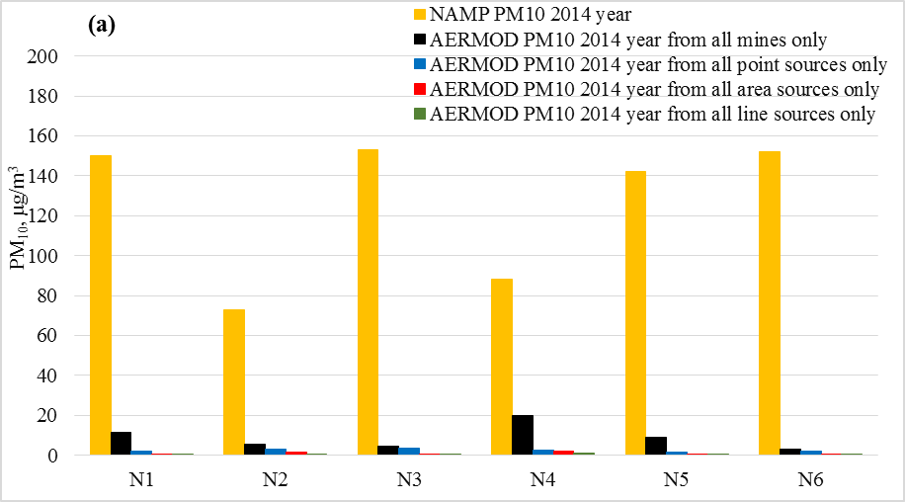
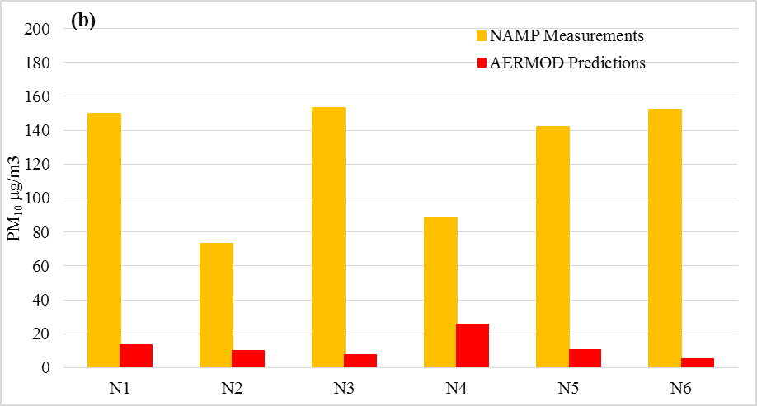
Comparison between PM₁₀ of Annual Average AERMOD Predictions for Point, Mine, Line and Other Area Sources with NAMP Observations for Year 2014

Slide 30
Contribution from Point, Line and Area sources to the PM10 Measured at the 6 NAMP Stations is 2 - 32% in the worst seasonal case scenario and Only point sources contribution is 2-6% in ground level mass concentrations
What are the reasons for
model under-estimations ?
FUGITIVES

Slide 31
Diagnostics
Sources and Measurements
100%
Fugitives - cookstoves, road dust
Errors
Vehicles
Assumed Industrial Sources are doubled
Current Industrial sources

Slide 32
FUGITIVES Use of Episodic Events to do the detective work ☺ 1. Rain versus No-Rains 2. Miners’ strike

Slide 33
Next two slides show the difference between Winter and Monsoon measurements (The fugitive dust is missing during monsoons)

Slide 34
Morning And Evening Hour PM10 And PM2.5 Measurements At 11-point Loop Locations For Winter Season, 2014

Slide 35
Morning and Evening Hour PM10 And PM2.5 Measurements at 11-point Loop Locations for Monsoon Season, 2014

Slide 36
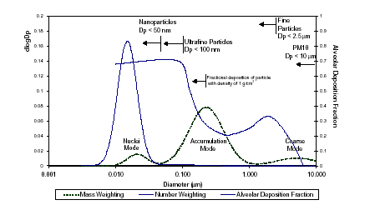
Tri-modal Particle Size Distribution
(Source: Kittelson et al. 1999)

Slide 37
Coarse mode was absent when it rained (Next slide)

Slide 38
Spatial Variations in Particle Mass Size Distributions Over Chandrapur Region
This Mode is absent when it rained

Slide 39
Effect of Rainfall on PM_{2.5} and PM₁₀ – 2016 - Pune
Black Line indicates 24 hr NAAQS (100µg/m³) for PM₁₀ and Red line indicates 24hr NAAQS (60 µg/m³) for PM_{2.5}

Slide 40
Effect of Rainfall on PM (2-year CAAQMS data) - Navi Mumbai
Black Line indicates 24hr NAAQS (100µg/m³) and Red line indicates annual NAAQS (60µg/m³) for PM₁₀

Slide 41
Miners’ Strike as an Episodic Event

Slide 42
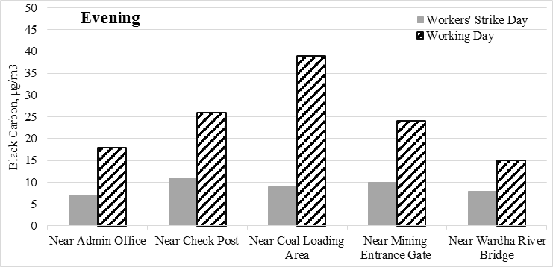
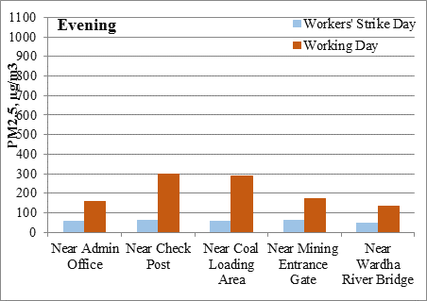
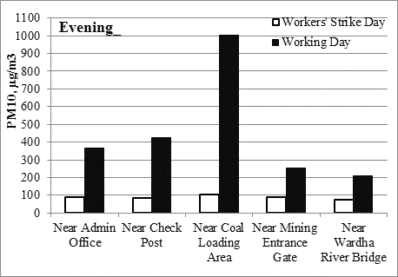
Comparison between PM₁₀ and PM_{2.5}, and Black Carbon (BC) Levels on the Day of Workers’ Strike with Levels on a Subsequent Day When Mining Operations Resumed

Slide 43
Case Study - Chandrapur
Monsoon time – was a good time to isolate the combustion sources from the “dust” emissions
Address domestic coal burning (key source of air pollution that is not accounted for) :
Better Coal “Chulha” ? Better fuel ?
Free electricity ?
Improved Road Design to prevent dust from gathering on the roads and prevent resuspension

Slide 44
Please see 20 Questions ppt for Exam related questions

Slide 45

Thank you for your Committed Engagement in the Classes

